Slide 1
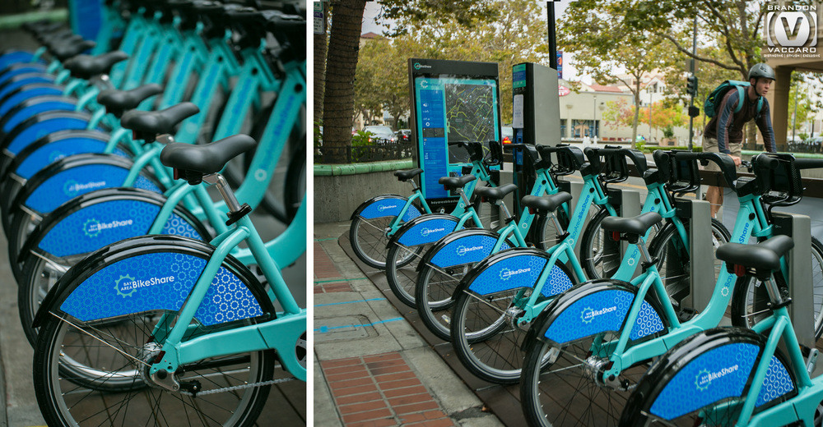

yc3238
Ya-Hsuan Chuo
- Understanding the route of bikes and examine whether the docks were built enough

Slide 2

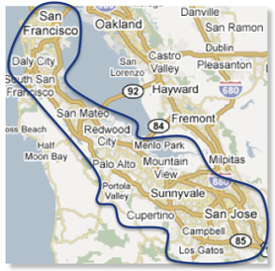

The Bay Area Bike Share is the region’s bike sharing system with 74 stations across the region, with locations in San Francisco bay area.
Source: https://cloud.google.com/bigquery/public-data/bay-bike-share
Datasets are the records of bike trips from 2013-08-30 to 2016-08-30 with 983,648 trips. The average demand is about 898 trip/per day.
37
7
7
5
18
The bike station’s distribution in the 5 landmarks
Notes:
The 74 stations are located in 5 different landmarks, and the distribution looks like the map on the right.
San Francisco and San Jose have the most bike stations.
The average demand is 898 trips per day. The demand is high, thus this sharing program should pay attention on management and investigate in more detail.

Slide 3
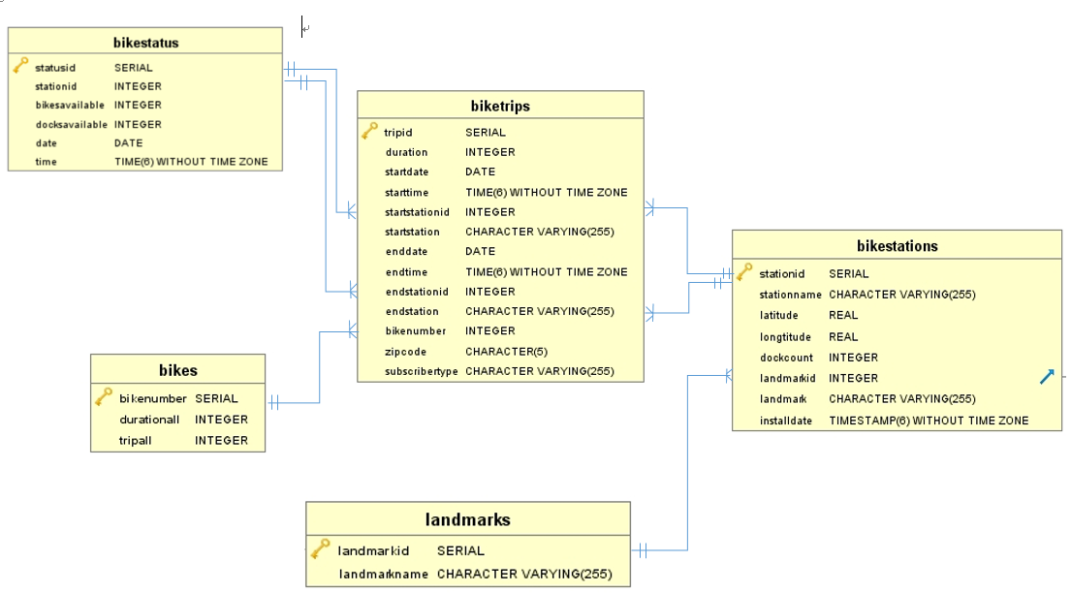
Normalization
Bikestatus
Biketrips
Bikestations
Bikestatus
Bikestations
Biketrips
Bikes
Landmarks
Notes:
Originally, I received three tables of raw dataset. After normalizing them, I have 5 tables and they are related to each other.
The main table is biketrips. It is the table with each trips’ information between 2013 to 2016. Bikestations is the 74 stations’ information.
Landmarks is the entity of the 5 landmarks that categorize the stations.
Bikes measure each individual bike’s usage, such as total duration and trips.
Finally, bikestatus is recorded by staff several times per day. The average measuring time in these 3 years per station is 130,000 times.
Some station that built recently would have less count of times.
These table are related to each other, the are all the information of bike trips and the stations in the bay area sharing program.

Slide 4


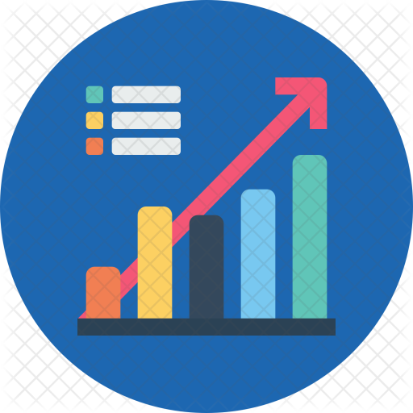

Motivate company handling the establish and planning for the bike share program
Advertising on those bikes that runs more time on the road rather than stationaries
Bike number
#535 #680 #262
Government would consider whether the bike share program is efficient in the area
Given the existing number of bikes now, are the docks in each station built enough to accommodate?
Notes:
Government and the Motivate company are two main entities that would care about this program. They focus on different topics.
Motivate company would provide bikes and they may want to put ads on some bikes that are frequently being used.
Such bikes are list on the slide.
I will focus more on the problem on government side about the management of the stations and bike routes.

Slide 5
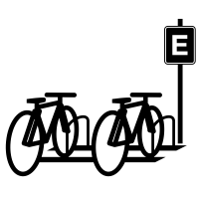





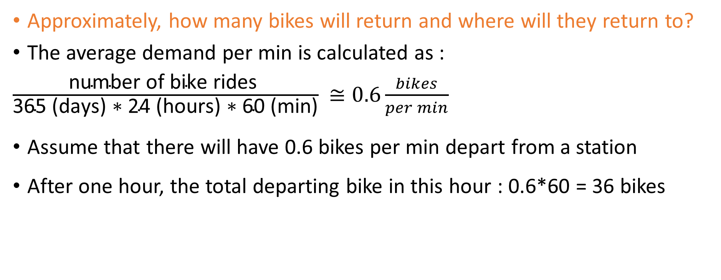
Approximately, how many bikes will return and where will they return to?
The average demand per min is calculated as :
$\frac{\text{number} \text{of} \text{bike} \text{rides} }{\text{365 }\text{(}\text{days}\text{)}\text{ ∗ 24 }\text{(}\text{hours}\text{)}\text{ ∗ 60 }\text{(}\text{min}\text{)}}$ $≅0.6\frac{bikes}{per min}$
Assume that there will have 0.6 bikes per min depart from a station
After one hour, the total departing bike in this hour : 0.6*60 = 36 bikes
Notes:
To examine whether the docks are enough or not, we should first estimate the demand of renting and forecast the demand of returning.
By calculating the average demand of bike renting per min, I used the number of rides in different years, and divided by the minutes.
Thus, I assume that there will be 0.6 bikes per minutes demand in each station. That is to say, every 1 min would have 0.6 bikes being rented.
After 1 hour, there will be 36 bikes that suppose to be in on the road. However, not every bikes that will bike through a hour.
So how many bikes will return after 1 hour, and does the end station have sufficient docks?

Slide 6

After 1 hour, some of the 36 bikes that depart from each 74 different stations will return, and some of them will still on the trip. The number of return bikes was estimated by survival analysis and the survival rate is calculated based on each station.
The end station is chosen by the most popular/frequent route from each start station
Compared with the docks in each end station, we can conclude that whether this station is able to accommodate the demand or not
Start station | End station | Landmark name | End Station’s Name | Return bikes | Docks | Return - Docks
2 | 4 | San Jose | Santa Clara at Almaden | 26.01927 | 11 | -15.0193
3 | 2 | San Jose | San Jose Diridon Caltrain Station | 23.28985 | 27 | 3.710149
4 | 2 | San Jose | San Jose Diridon Caltrain Station | 26.99729 | 27 | 0.002712
5 | 2 | San Jose | San Jose Diridon Caltrain Station | 26.26763 | 27 | 0.732369
6 | 2 | San Jose | San Jose Diridon Caltrain Station | 25.60135 | 27 | 1.398645
7 | 2 | San Jose | San Jose Diridon Caltrain Station | 25.70061 | 27 | 1.299393
8 | 11 | San Jose | MLK Library | 25.53897 | 19 | -6.53897
--- | ----- | ----- | ---- | ---- | ---- | ---

Slide 7
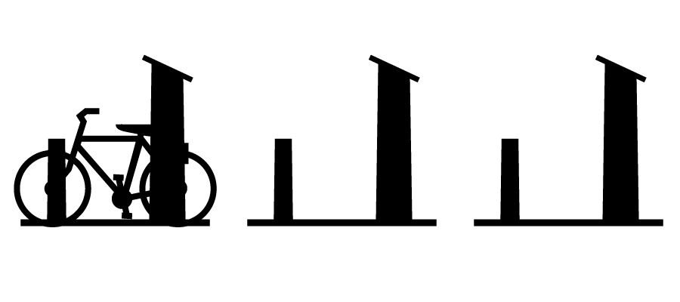

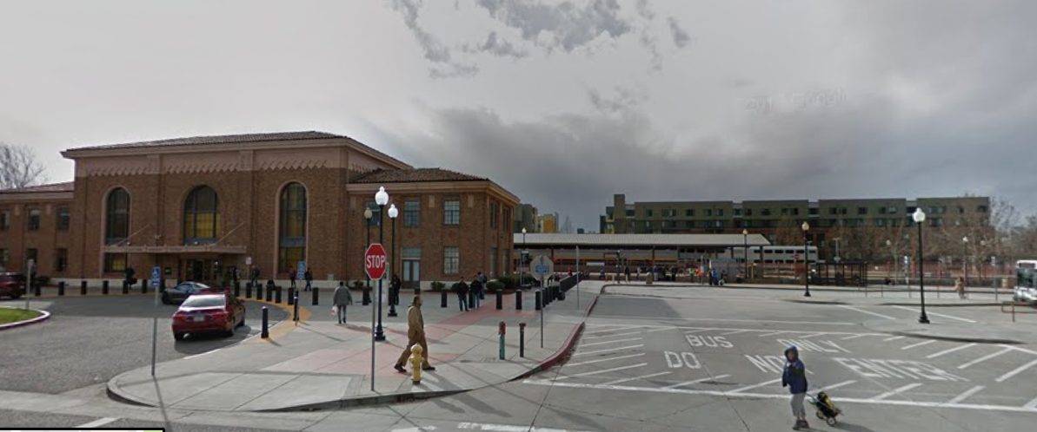
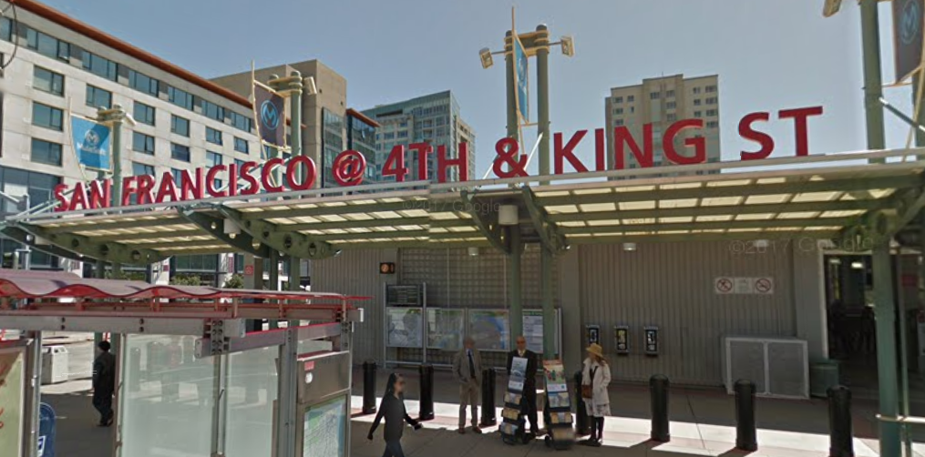

Sufficient docks & popular end station
Insufficient docks & popular end station
San Jose Diridon Caltrain Station
San Francisco Market at Sansome
San Francisco caltrain (Townsend 4th) (70)
San Francisco caltrain (300 Townsend) (69)
Station & Markets are popular tourist spots
Consider build another station around this area?
Popular end station
- Both located in the popular tourist spot/city center
San Jose Diridon Caltrain Station – 20%
San Francisco Caltrain (Townsend at 4th) – 15%
Highly insufficient docks – be aware of these stations!
Santa Clara at Almaden
Cowper at University
Mountain View City Hall
2nd at South Park
San Antonio Shopping Center
Broadway at Main
Townsend at 7th
Notes:
The station have sufficient docks are only 2 or 3 more docks than demand based on estimation. They have more people using in tourists spot or city center.
The popular stations are San Jose Diridon Caltrain Station and San Francisco Caltrain(Townsend at 4th). They have 20% and 15% relatively time based on the total trips that people return bikes to there.
In San Francisco Caltrain area there are two bike stations. From the data, we can tell that they have highly demand however the bike docks is not sufficient. We can consider to built more station there or increase the docks.
We should be aware of the stations with insufficient docks. They are not located in a specific landmarks.

Slide 8
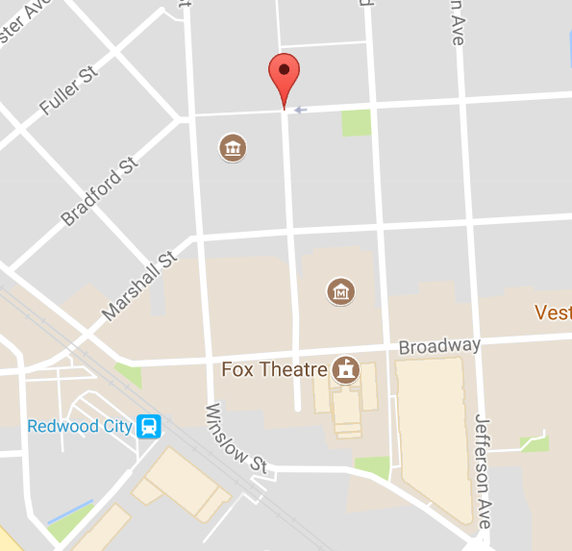
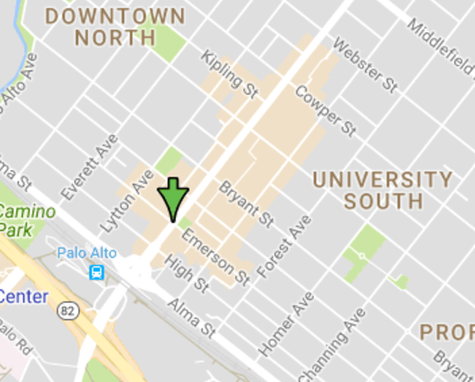
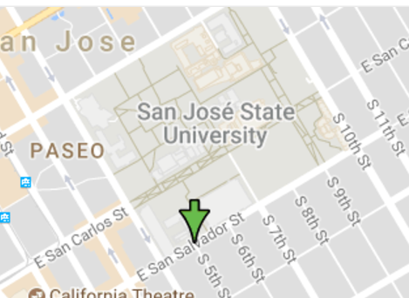
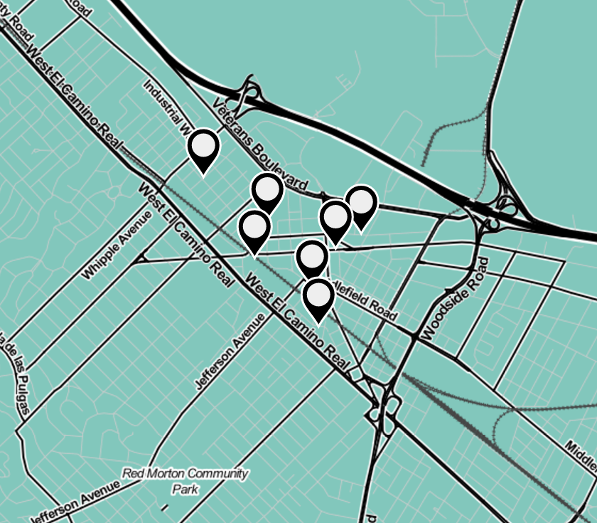
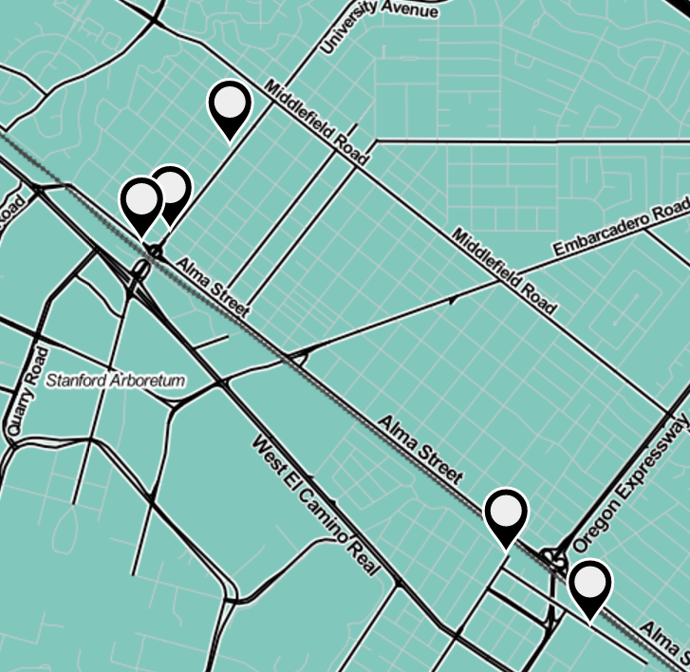
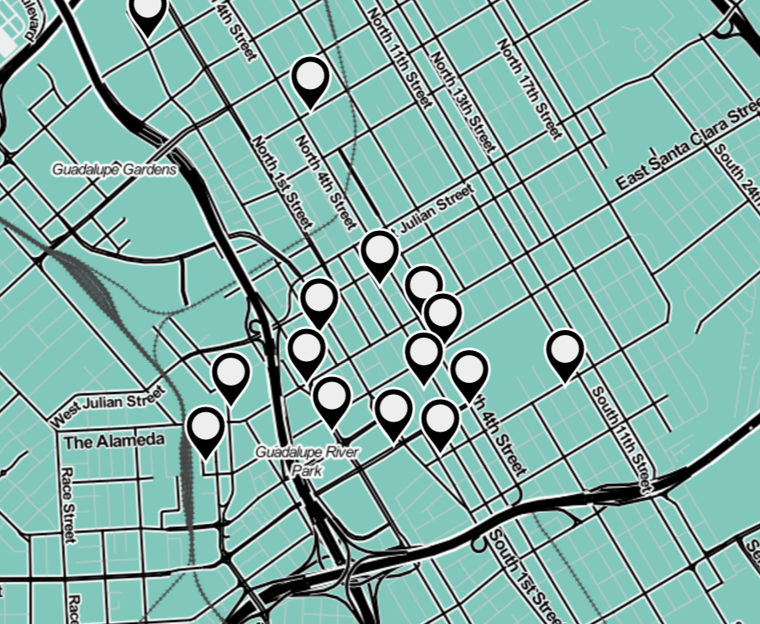
San Mateo County Center, Redwood City
University and Emerson, Palo Alto
5th S. at E. San Salvador St, San Jose
This is interesting. People started and ended at the same station at these three stations most of the time.
These three places are located near university or county center.
We can tell from the map that it is because the bike is not used for commuting. They may use for a one-time event, such as buying grocery, or tourists looking around this place.

Slide 9
Highly insufficient stations
landmarkid | Station name
4 | Santa Clara at Almaden
37 | Cowper at University
27 | Mountain View City Hall
64 | 2nd at South Park
31 | San Antonio Shopping Center
25 | Broadway at Main
65 | Townsend at 7th
Start and end at the same station?
landmarkid | Station name
23 | San Mateo County Center
35 | University and Emerson
88 | 5th S. at E. San Salvador St
It may because these stations close to stations
that are highly insufficient.
In the future, we can consider building more bike station near these area.
People may feel inconvenient because they need to return to their origin station because they didn’t find a better place around to return.
Notes:
Note: station id that are closed together means that are located near each other.
Only station id after 88 were built after 2013. They are separate in different place.

Slide 10
Recommendations & Further analysis
We should really pay attention to the stations with insufficient docks.
Also consider to build more station near those station that customers start and end at the same place.
Some duration of trips are over 24 hours.
New station installed after 2013 need more data to analyze.
Trips over 24 hours??? Did they really rent the bike over 24 hours?
 | Times | Total | Propotion
stations | 66 | 74 | 89 %
trips | 289 | 983648 | 0.3 %
Time series analysis
Geographical analysis
Need customer’s data
Notes:
Issues:
Duration over 24 hours: Maybe it is because they didn’t return correctly so they fail to return and they did not know. This question should be solved with more data such as customer’s complaint records or feedback.
New station installed after 2013 are : 33, 82, 83, 84, 88, 89, 90, 91, they are located in Redwood city, San Francisco, and San Jose. They need more data to analyze and forecast the demand in the future.
Further analysis:
Time series analysis: I didn’t use the bikestatus table this time. However, this table is like a personal profile for each station. We can see how this three years, in each time slots does the station have been used for rent and return. We can focus more detail on forecasting the demand in each month, day or even hour. Certain time slots may have high demand. We should make sure that stations not to be fully packed or with zero bikes to rent for customers.
We can also combine geographical analysis. Stations that close together may have relationship. Because people who can’t borrow a bike at a station they want they will look around the station nearby.
Understand the customer’s behavior: Data from user’s information can help us examine the characteristics of customers. Does users often bike from home? What is the purpose they use the bike for? More importantly, we can answer the question combine with customer’s data: How likely will I find an available dock at a station?

